Slide 1
System Flowchart
Inventory Management System
Lucky Bhardwaj
Tony Medina
Jason Jung
Ben Chang
Asther Letada

Slide 2
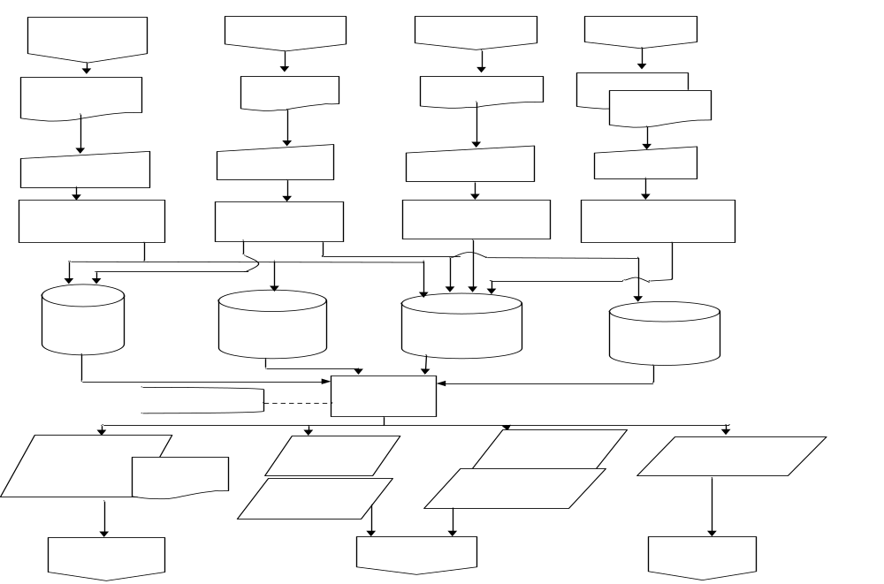
The Flowchart

Slide 3
Table of contents
Slides 4-7 describe the top 4 columns from left to right. For example slide 4 deals with the left most column and the 4 squares underneath it, slide 5 deals with the second column and the 4 squares underneath it and so on and so forth
Slides 8 and 9 talk about the middle of the flowchart, discussing how the information is stored in files
Slides 10 and 11 discuss everything after “Print Reports” on the flowchart
And finally the last 2 slides discuss threats and controls

Slide 4
Flowchart Description
First, a retail company receives the merchandise reorder reports.
They take the data from those reports and key it into the computer to create a record (which is the basic process of taking data and converting it into information).
They then take each record and store it into different files.

Slide 5
Flowchart Description (cont..)
Retail company receives receiving report.
They then input the data from the report into the computer.
That data is then converted into information in the form of records.
The records are then stored into different files (one of which adds to inventory on-hand balances).

Slide 6
Flowchart Description (cont..)
Retail company receives shipping report from the sales department.
They then take the data from the report and input it into the computer to create information in the form of records.
They then take the individual records and store them into separate files (which in turn deducts from the inventory on-hand balances).

Slide 7
Flowchart Description (cont..)
Retail company received credit and purchase/debit memo.
Return data is keyed into the computer.
That data is then converted into information in the form of records.
These records are then stored into different files that will update / change on-hand balances to reflect the adjusted quantities.

Slide 8
Flowchart Description (cont..)
The Open Purchase Order File, Purchase Transaction File and Merchandise Inventory Master File (a permanent file) are updated when the quantity ordered are inserted into inventory records.
The Open Purchase Order File, Merchandise Inventory Master File and Receipts Transaction File are updated after the quantities received have been added to on-hand balances.

Slide 9
Flowchart Description (cont..)
Only the Merchandise Inventory Master file is updated after the shipped quantities have been deducted from oh-hand balances.
Lastly, only the Merchandise Inventory Master File is updated after the changes on the on-hand balances are made to reflect the adjusted quantities.

Slide 10
Flowchart Description (cont..)
Once all the information is stored and the files are updated, reports are printed (daily).
The Open & Overdue Purchase Orders Reports and the Purchase Order document are sent to the Purchasing Manager.
- These reports help the manager understand which orders are open and which ones are overdue. (Basically showing which orders the company still needs to receive and which orders are overdue)
The Receiving Manager receives the Summary of merchandise receipts
- A report of all the merchandise that was received on that day.

Slide 11
Flowchart Description (cont..)
Inventory Management receives 4 different reports:
Inventory Status Report – A report that shows where you stand on your inventory. (how much inventory you have on hand)
Inventory Usage Report - How much inventory is being used at the current output level.
Expected Stock-out Report – How much and what inventory you expect to be sold out
Merchandise Reorder Report – A report that shows what inventory needs to be reordered

Slide 12
Threats & Controls
Systems outage failure or computer crash
- Create backups (on site/off site).
Theft and computer fraud
- Identification codes
- Password systems and levels of access
- Segregation of duties
- Rotating clerks to do different processes
- Encryption of data

Slide 13
Threats & Controls
Recording and posting errors in Inventory (human error).
- Create various data entry and processing edit controls
- Checks and balances
- Better trained staff
Information overload
- Output security controls (minimum number of copies for each printed report).

